Slide 1
COLLEGE MANAGEMENT SYSTEM
TEAM-MEMBERS
S.DHARANI-EBEON0322575081
r.monishA RAMESHBABU-EBEON0322582330
r.Revathi-EBEON322570615
K.RAMYA-EBEON0322571078
A.PRIYADHARSHINI - EBEON0FWL562309
Guided by
A.Varadharajan

Slide 2
MODULES
ADMISSION
ALUMNI
EVENTS
LABORATORY
PLACEMENT
CONTACT US
COURSES
LIBRARY
ANNUAL REPORT
FACULTY
INFRASTRUCTURE
FEE STRUCTURE
RESEARCH
ONLINE PAYMENT
CHATBOT

Slide 3
HARDWARE REQUIREMENTS
Windows 10
RAM - 4 GB
MEMORY - 64 BIT
SOFTWARE REQUIREMENTS
Eclipse IDE
Java jdk -18
Springboot-Thymeleaf,MVC
Hibernate- JPA
MySQL
H2DB
Maven

Slide 4
STUDENT ADMISSION
We are going to build a simple course Management System web application using Spring Boot, Spring MVC, Thymeleaf, Spring Data JPA, and MySQL database.
These are the tools which I used to run my module :
Java 18
Spring Boot
Spring MVC
Eclipse IDE
Thymeleaf
Spring Data JPA(Hibernate)
Mysql
Maven

Slide 5
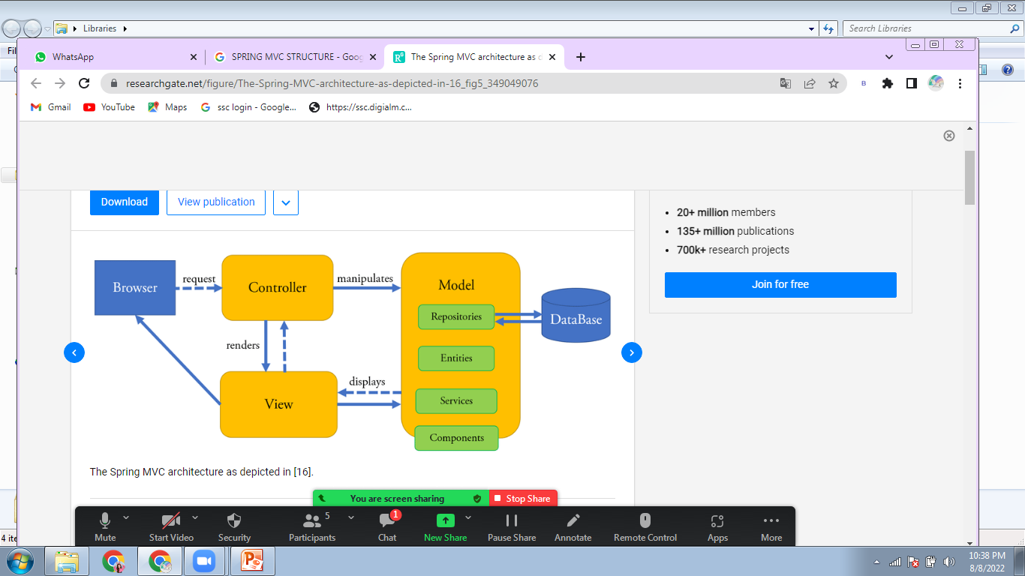
PROJECT STRUCTURE

Slide 6
STRUCTURE
Dashboard
DASHBOARD
SNO
STUDENT FIRST NAME
STUDENT LAST NAME
MAIL-ID
ADD
UPDATE
DELETE

Slide 7
LABORATORY
We are going to build a simple Lab Management System web application using Spring Boot, Spring MVC, Thymeleaf, Spring Data JPA, and MySQL database.
These are the tools which I used to run my module :
Java 18
Spring Boot
Spring MVC
Eclipse STS
Thymeleaf
Spring Data JPA(Hibernate)
Mysql
Maven

Slide 8
PLACEMENT
We are going to build a simple PlacementSystem web application using Spring Boot, Spring MVC, Thymeleaf, Spring Data JPA, and MySQL database.
These are the tools which I used to run my module :
Java 18
Spring Boot
Spring MVC
Eclipse STS
Thymeleaf
Spring Data JPA(Hibernate)
Mysql
Maven

Slide 9
Dataflow diagram
Dashboard
PLACEMENT
NAME
MAIL
NAME
ADD
UPDATE
DELETE

Slide 10
LIBRARY
Easy to learn ,Object-Oriented , Robust ,Platform Independent ,Secure , Multithreading , Architectural neutral ,High performance
The main objective of this project is to manage the details of the books, author, category, and publisher. Only Admin/Librarian will manage all these activities. Also, they can export the data in CSV file format.

Slide 11
Technologies Used
1.JDK 17
2.Spring Boot
3. Thymeleaf
4.Spring Security
5.Spring MVC
6.H2DB
7.Maven
8.OpenCSV
Login
Dashboard
Book
Author
Publisher
Category
Update
View
Delete
View
Delete

Slide 12
COURSE
We are going to build a simple course Management System web application using Spring Boot, Spring MVC, Thymeleaf, Spring Data JPA, and MySQL database.
These are the tools which I used to run my module :
Java 18
Spring Boot
Spring MVC
Eclipse STS
Thymeleaf
Spring Data JPA(Hibernate)
Mysql
Maven

Slide 13
STRUCTURE
Dashboard
COURSE
SNO
COURSE
DEPARTMENT
HODNAME
DEPTMAIL
ADD
UPDATE
DELETE

Slide 14
FACULTY
We are going to build a simple Lab Management System web application using Spring Boot, Spring MVC, Thymeleaf, Spring Data JPA, and MySQL database.
These are the tools which I used to run my module :
Java 18
Spring Boot
Spring MVC
Eclipse STS
Thymeleaf
Spring Data JPA(Hibernate)

Slide 15
Dataflow diagram
Dashboard
FACULTY
FIRST NAME
LASTNAME
MAIL-ID
ADD
UPDATE
DELETE

Slide 16
ONLINE PAYMENT
DEFINITION
In this module, we will learn to implement the Paytm as a Payment Gateway in our spring boot application.
As we already know it is one of the most popular services which enables the fastest and safest way of doing payment over the internet.
Here we will create a project from springboot and integrate the Paytm using MERCHANT ID, MERCHANT KEY,INDUSTRY ID,CHANNEL ID and so on in application properties, so that anybody can do the payment through our application.

Slide 17
STEPS
Step 1: Create a Project from Spring Initializr and also add the following dependencies,
Spring Web.
Spring Boot DevTools.
Thymleaf
Step 2: After extracting the project, import the project in your IDE such as Eclipse.
Step 3: Get Paytm Properties such as Merchant ID, Merchant Key, etc.
Login or Sign up to your Paytm account using this url: https://dashboard.paytm.com/
Go to the Developer setting on the left-hand side of the site.
Choose API Keys.

Slide 18
Select Generate Test API Details.
You will get Test Merchant ID and Test Merchant Key.
Step 4: Configure the application.properties file by using these details from DEVELOPER SETTINGS from your Paytm account.
Step 5: Create a POJO CLASS, Controller Class
Step 6:When the API gets called then it will return home.html, where we will write the HTML to display the form
Step 7:Validating the checksum and finally displaying the data on the report.html file. For validating the checksum we defined a method validateCheckSum()
STEP 7: PaytmChecksum to ensure that API requests and responses shared between your application and Paytm over network have not been tampered with.
STEP 8: But before Running make sure that you have all the dependencies as mentioned in the pom.xml file.

Slide 19
CHATBOT
DEFINITION
A Chatbot is an application designed to simulate conversation with human users, especially over the Internet.
Internally it uses any NLP (Natural Language Processing) system to interpret the human interactions and reply back with meaningful information.
AIML (Artificial Intelligence Markup Language) is an XML dialect for creating natural language software agents.
It contains the basic rules which Natural Language Understanding (NLU) unit uses internally.
It can be thought of as the heart of the engine. The more rules we add in AIML – the more intelligent our Chatbot will be.
It helps in parsing unstructured inputs e.g. mispronunciations, swapped words, contractions, colloquialisms, and other quirks.

Slide 20
PREREQUISITES
Reference AIML Implementation
To get started, we shall use an already working reference application.
There is one such java based implementation called program-ab hosted on google-code repository.
Download the program-ab latest distribution from maven code repository.

Slide 21
STEPS
STEP1:Create eclipse project
STEP 2: Import AIML library
After we have created the maven project to start the development, let us choose packaging as jar and maven coordinate as your choice and import to eclipse.Now create a folder lib in the base folder and copy the Ab.jar from the program-ab distribution to this folder.
STEP3:Add AIML to Classpath
To add AIML to classpath, add Ab.jar to deployment assembly in eclipse. Alternatively, you can install this jar into your local maven repository and then use it.
To install locally, place the jar in any folder and provide that location in the systemPath tag. Now, add below AIML maven dependency to pom.xml. Now build the maven project by command mvn clean install.
STEP 4: Conclusion
In this AIML chatbot, we have learned to create a simple command-line based chatbot program with program-ab reference application.

Slide 22
FUTURE ENHANCEMENT
Online notes can be provided
Online Attendance to be maintained
Exam records will be shown

Slide 23
IT’S QUESTION TIME

Slide 24
THANK YOU

